Slide 1
A/B Testing
Project
By Louis Ampobi

Slide 2
Introduction
An A/B test was employed by Vanguard because they believed a more intuitive and modern User Interface (UI), coupled with timely in-context prompts (cues, messages, hints, or instructions provided to users directly within the context of their current task or action), could make the online process smoother for clients.
Objective
What I would attempt to answer with this analysis is if the new UI leads to higher completion rates?

Slide 3

Data Overview
There were three datasets(four really) , here is a break down of that:
Client Profiles: Demographics like age, gender, and account details of our clients.
Digital Footprints: A detailed trace of client interactions online, divided into two parts: pt_1 and pt_2. It’s recommended to merge these two files prior to a comprehensive data analysis.
Experiment Roster: A list revealing which clients were part of the grand experiment.
After cleaning and joining we had data points of 321195 entries .

Slide 4
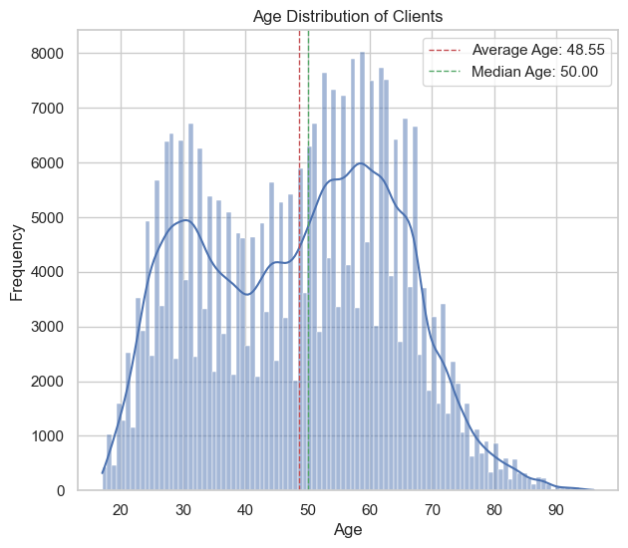
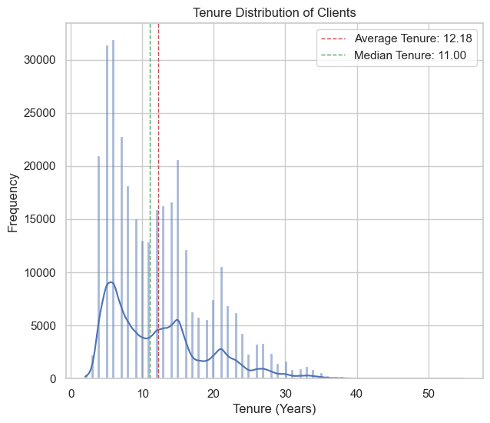
Exploratory Data Analysis Client Analysis by age and tenure
Results: Average Age: 48.53 years.
Median Age: 50 years.
Average Tenure: 12.18 years.
Median Tenure: 11 years.

Slide 5
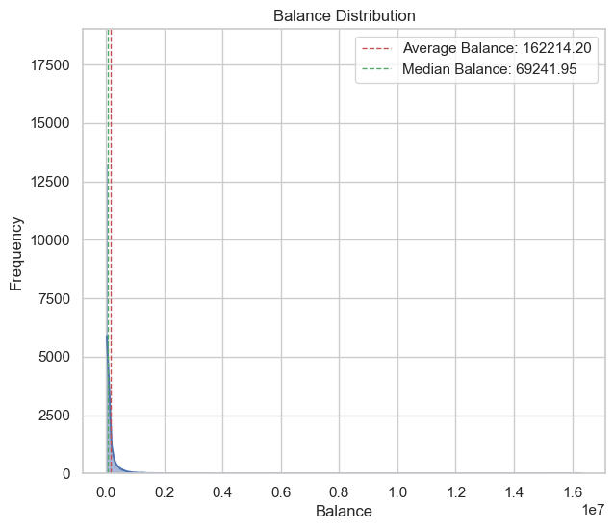
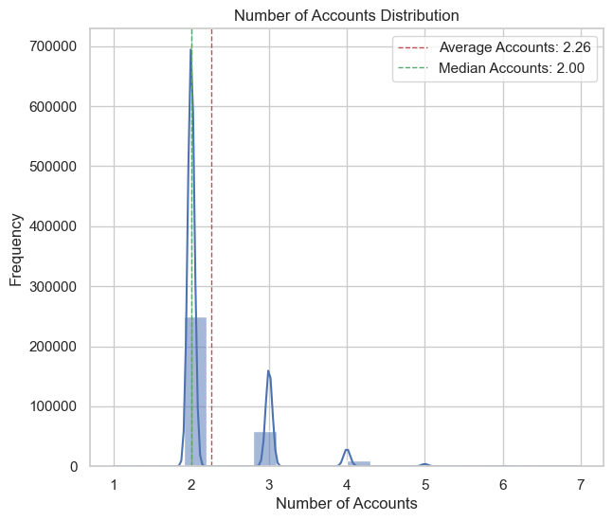
Exploratory Data Analysis Client Analysis by Account
Average Balance: $160,802.51.
Median Balance: $69,090.98.
Average Number of Accounts: 2.26.
Median Number of Accounts: 2.

Slide 6
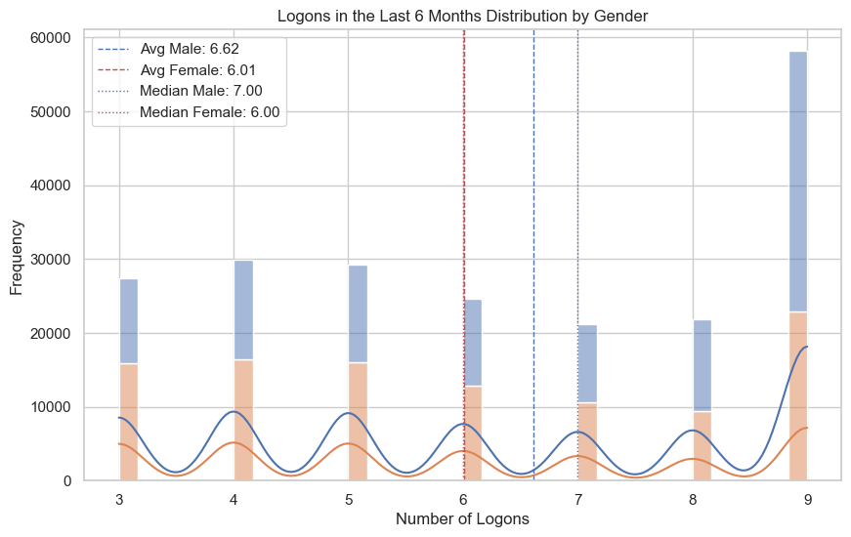
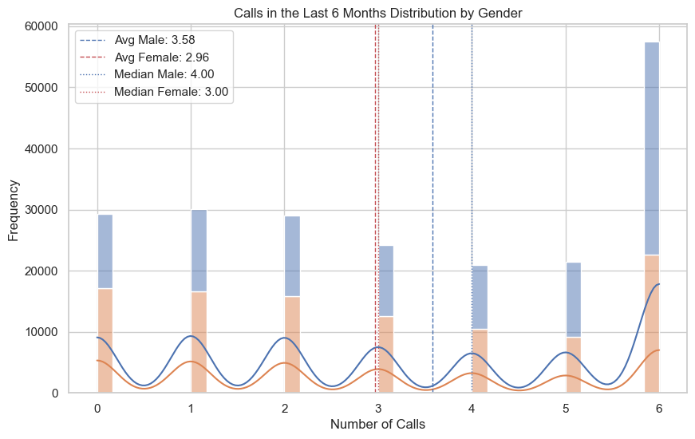
Exploratory Data Analysis By Behavioral Analysis gender

Slide 7
Exploratory Data Analysis Summary
Demographics:
The primary clients are middle-aged, with an average age of 48.53 years and a median age of 50 years.
They have substantial tenure, averaging 12.18 years, indicating a mix of new and long-standing clients.
Client Behavior:
Clients typically hold around 2 accounts.
Account balances vary widely, with an average balance of $160,802.51 and a median balance of $69,090.98.
Interaction frequency is moderate, with an average of 3.23 calls and 6.27 logons in the past 6 months.

Slide 8
Performance Metrics
Our KPI’s and their definitions
Completion Rate: The proportion of users who reach the final ‘confirm’ step.
Time Spent on Each Step: The average duration users spend on each step.
Error Rates: If there’s a step where users go back to a previous step, it may indicate confusion or an error. You should consider moving from a later step to an earlier one as an error.

Slide 9
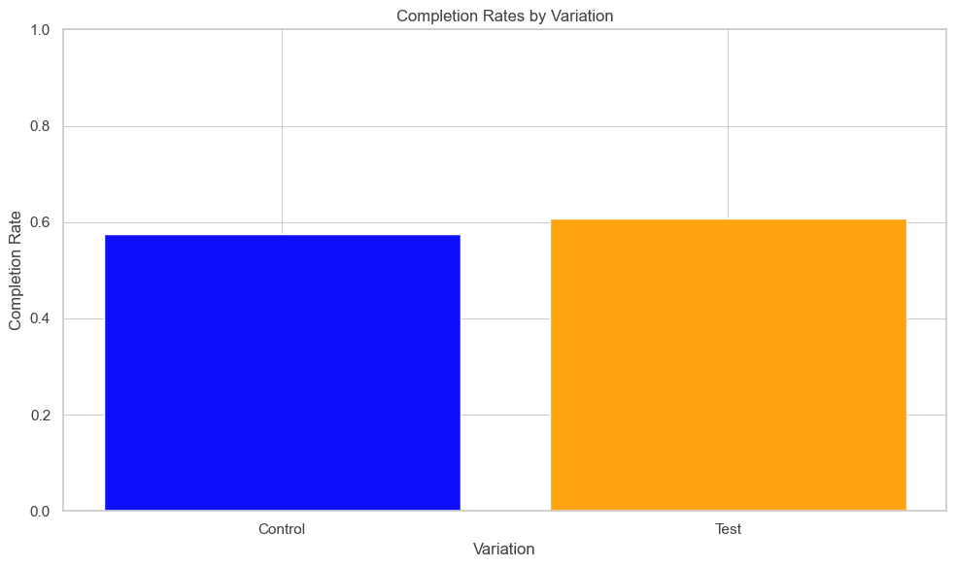
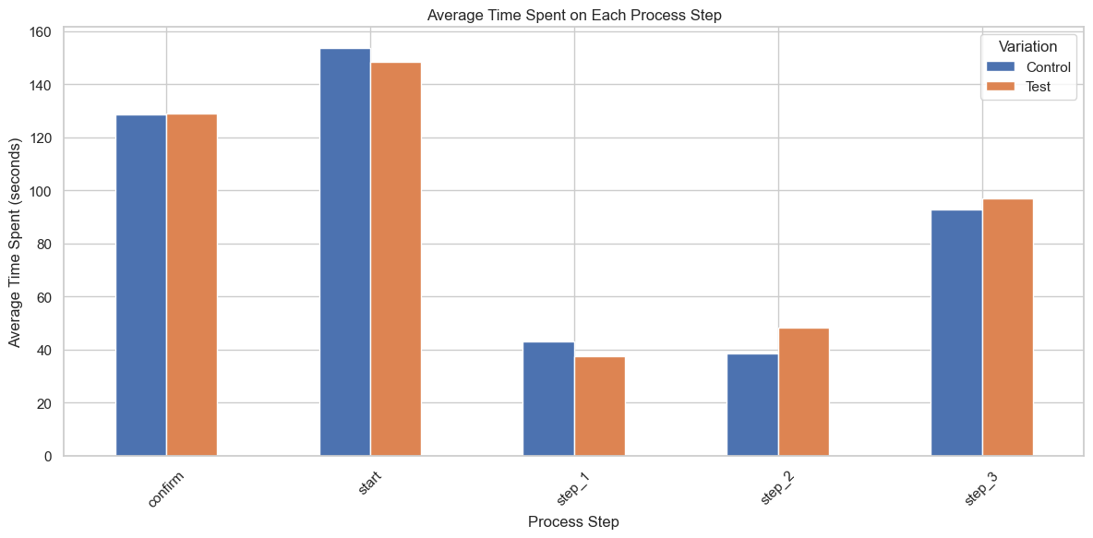
Performance Metrics
The Test Group has a higher completion rate ( 60.83%) compared to the Control Group (57.45%).
Early Steps: New design improves efficiency.
Later Steps: New design introduces delays, indicating areas for improvement for majority of steps.

Slide 10
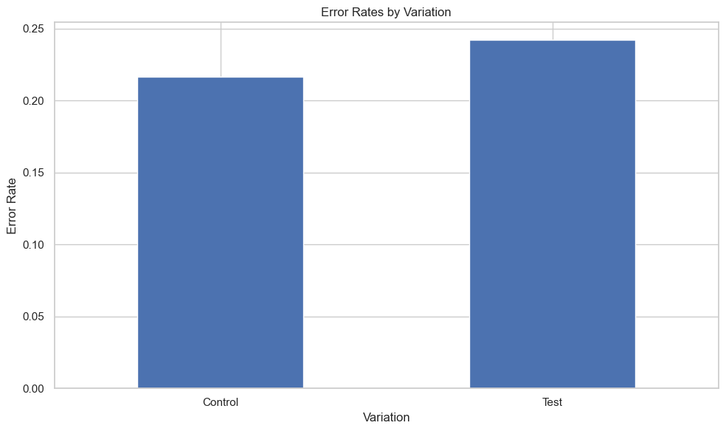
Performance Metrics
Error Rates:
Higher error rate in the Test group suggests the new design may cause more user confusion or errors.

Slide 11
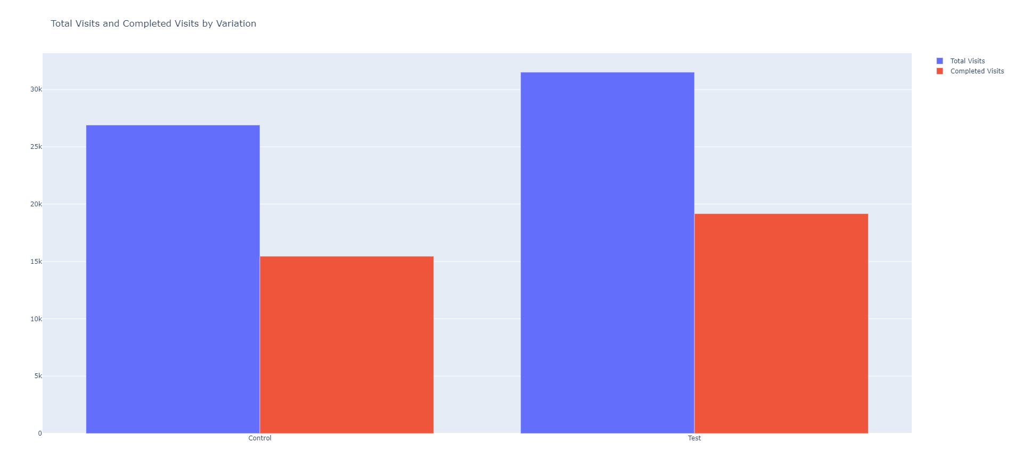
Hypothesis Testing
Hypothesis Definition
Null Hypothesis (H0H_0H0​): The completion rate for the Test group (new design) is equal to the completion rate for the Control group (old design).
Alternative Hypothesis (HaH_aHa​): The completion rate for the Test group (new design) is not equal to the completion rate for the Control group (old design).

Slide 12
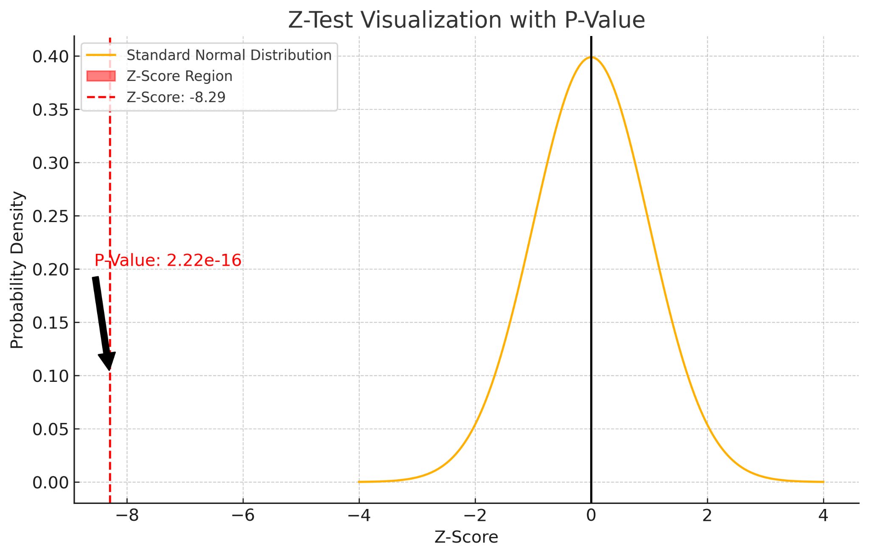
Hypothesis Testing
Hypothesis Conclusion
Interpretation Completion Rates:
Control group: 57.45% Test group: 60.83% Z-Statistic: -8.29
P-Value: 2.22 × 1 0 − 16 2.22×10 −16
Given the p-value is significantly lower than the significance level of 0.05, we reject the null hypothesis. This means the difference in completion rates between the Test and Control groups is statistically significant.

Slide 13
Further Hypothesis Testing
Hypothesis Definition
Null Hypothesis (\(H_0\)): The completion rate for the Test group (new design) is equal to or less than the completion rate for the Control group (old design) increased by 5%.
Alternative Hypothesis (\(H_a\)): The completion rate for the Test group (new design) is greater than the completion rate for the Control group (old design) increased by 5%.
Results
The Z-statistic of -22.5987 indicates that the Test group's completion rate is significantly lower than the Control group completion rate increased by 5%.
The P-value of 1.0, being much larger than the typical significance level (e.g., 0.05), means we fail to reject the null hypothesis.

Slide 14
Conclusion
Design Decision: The new design (Test group) does not show a statistically significant improvement over the old design (Control group) when adjusted for a 5% increase in completion rate. It suggests that the new design may not be more effective than the old design under the given conditions.
Further Investigation: We should consider revisiting the design changes or the threshold used. Additional factors and more data might provide further insights.

Slide 15
Recommendations
Additional data that could enhance the analysis includes:
Demographic Information: Age, location, and other demographic variables.
Behavioral Data: Detailed user interactions (click patterns).
Feedback and Surveys: Qualitative feedback from users about their experience.
External Factors: Information about marketing campaigns or external events during the experiment period.

Slide 16
Recommendation
2. Additional data that could enhance the analysis includes:
Refining steps where new UI shows more time might serve to increase user experience
Focus on optimising step 2 and step 3 since the took a lot more time.

Slide 17

Thank You!

